Slide 1

Esperanza High School
Distinguished Scholars & Advancement Placement Night
Welcome to the Class of 2021
“Where Excellence is a Tradition”

Slide 2
Administration
Principal - Dr. Ken Fox
Assistant Principals - Gina Aguilar & Phil Dominguez
Counselors - Brianne Gullotti, Yvette Kettering & Amy Selof
Activities Director - Meghann Lukach
Athletic Directors - Matt Slevcove & Keri Walters
College & Career Technician - Abbey Combs

Slide 3
Recognitions & Distinctions
California Distinguished School
California Gold Ribbon School with Fine Arts distinction
Silver Medal Award - US News & World Report’s Best High Schools
80% overall pass rate on Advanced Placement exams
Specialized programs:
  Medical Sciences Academy
  Aztec Engineering Manufacturing Academy (AEM)
  AFJROTC
  Teacher Preparation Pathway (starting Fall 2017)

Slide 4
Distinguished Scholars Program

Slide 5
Why Distinguished Scholars
Top academic program at Esperanza
Students who complete the requirements position themselves to have the best opportunity for admission into the most competitive universities nationwide
Students receive yearly recognition (luncheon, token of appreciation, recognition night)
Distinguished Scholar graduates wear a unique cap and gown at graduation, have front row seating, and receive a Distinguished Scholar diploma and transcript seal.

Slide 6

Distinguished Scholars are also athletes, musicians, Club Members, Etc.

Slide 7
9th Grade Entry Requirements
Middle School Academic GPA of 3.5 or higher
No grade lower than a “C”
Satisfactory citizenship marks

Slide 8
Distinguished Scholar Diploma Requirements
Students must meet 4 of the 5 categories below:
Language Arts - 3 years of honors/AP
Math - 3 years BEYOND Geometry (at least 2 honors/AP)
Science - 4 years (at least 3 honors/AP)
Social Science - 3 years (all 3 AP)
World Language - 3 years (at least 2 honors/AP)
And also have:
Fine Art - 1 year
4.0 weighted academic GPA through 7 semesters

Slide 9
Application information
Available now on the “Bulletin Board” on our website front page:
  www.esperanzahs.net
Complete application & have it signed by Middle School Counselor
Deadline - Friday, March 24, 2017
  Students attending one of our feeder middle schools (BYMS, TRMS, YLMS)- drop off at EHS front office or have your student leave it with their Middle School Counselor
  Students not attending a feeder middle school - drop off at EHS front office.

Slide 10
Questions?
Please call or email me:
Gina Aguilar
gaguilar@pylusd.org
(714) 986-7540 ext. 13004

Slide 11
Honors and Advanced Placement Information

Slide 12
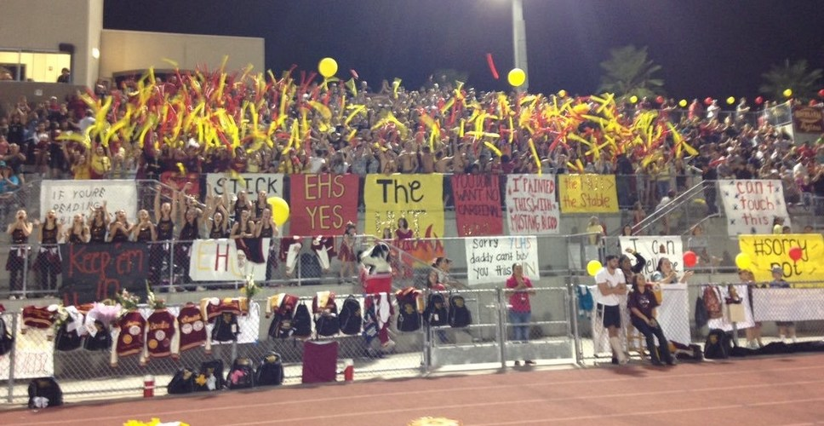
Counselor
Amy Selof

Slide 13
Honors Courses
We offer 15 honors courses:
Language Arts - LA 1, LA2
Math - Geometry, Alg 2/Trig, Pre-Calculus
Science - Biology, Chemistry
Social Science - none
World Language - French, German, Japanese & Spanish - levels 2 & 3

Slide 14
Advanced Placement Courses
We offer 22 Advanced Placement courses:
Language Arts - English Language (11th), English Literature (12th)
Math - Statistics, Calculus AB, Calculus BC
Science - Biology, Chemistry, Environmental Science, Physics
Social Science - Human Geography (9th), European History (10th), United States History (11th), United States Government (12th), Macroeconomics (12th)
World Language - French, German, Japanese, Spanish
Studio Art - 2D, 3D, Drawing
Computer Science Principles

Slide 15
What Is An Honors/AP Student
An Honors/AP student is self-motivated and organized
An Honors/AP student has strong time-management skills
An Honors/AP student thinks critically and analytically
An Honors/AP student is able to keep up with quick-paced instruction and a heavier homework load
An Honors/AP student goes beyond minimum expectations
An Honors/AP student is able to balance academics with extracurricular activities

Slide 16
Why Honors/AP?
To challenge yourself
  Start thinking like a college student
  Concentrate on subjects that interest you
To earn college credit
  Over 2,600 colleges worldwide grant credit for passing AP exams
To broaden college & career choices
  All Honors/AP courses receive a weighted grade point in your GPA if you earn a grade of “C” or higher
  Be more prepared for your first year of college
  Colleges factor in high school rigor very heavily when evaluating applicants.

Slide 17
College Entrance Factors
Grade Point Average (GPA)
Standardized Test scores (SAT, ACT)
Rigor of high school schedule
College essays, personal statements, letters of recommendation
Extracurricular activities
Note - This is all within the context of what is available at your own school.

Slide 18
Language Arts
Kathy Owens

Slide 19
LA I & II HONORS EXPECTATIONS
A student in a Language Arts Honors class:
goes beyond minimum expectations frequently
displays self-motivation and an honors work ethic
will read assigned difficult material(s) outside of class and accept daily accountability for that reading
must exhibit depth and insight into literature and a willingness to develop these skills
must produce quality writing which indicates a depth of understanding and careful attention to detail and mechanics
must willingly participate in class discussions
practices good time-management skills
is responsible for his/her own success, in regard to absences, make-up work, etc.
must manage the faster pace

Slide 20
A.P. English Language and Composition and A.P. English Literature and Composition
Students are exposed to a variety of writing spanning various times and cultures.
Students will enhance their skills as discerning readers and critical thinkers and writers.
Both courses involve reading, comprehension quizzes and tests, and written responses and analyses.
Students are expected to read independently and be able to manage up to an hour of reading at night/weekend
Students are expected to be self-motivated learners who will participate in class discussion.
Students are expected to ask questions and seek answers both in class and independently.
A.P. English Language and Composition | A.P. English Literature and Composition
Students read primarily non-fiction in the form of essays, autobiographies, articles, and historical documents. | Students read fiction in the form of poetry, novels, plays, and short stories.
Writing is synthesis, argumentative, and rhetorical analysis. | Writing poetry, prose, and literary analysis.

Slide 21
Math
Debbee Mariotti
Matt Varney

Slide 22


Algebra IA
Esperanza High School
Mathematics Course Sequence
2015-2016
Algebra I
Algebra IB
Geometry
Geometry H
Algebra II/ Trigonometry
Algebra II/ Trigonometry H
Precalculus
Precalculus H
Statistical Reasoning in Sports
AP Calculus AB
AP Statistics
AP Calculus BC

Slide 23
AP Calculus AB
AP Calculus is the perfect starting point for those wanting to study a S.T.E.M. field in college.
Calculus AB is the equivalent of first semester calculus at a college.
This is a fast paced class that requires students to continually apply the topics covered in this class and in previous classes to a variety of problems and real world situations.
Students enrolled in AP Calculus AB will have the opportunity to receive college credit for a semester of calculus by either taking the AP Exam in May, or by enrolling in the CSUF High School Honors Program and receiving a grade from CSUF for the course.
Calculus AB Students should expect 20-30 minutes of homework each night.
I have a pass rate of about 82%.

Slide 24
AP Calculus BC
This class is the equivalent of two semesters of college calculus.
Students enrolled in AP Calculus BC will have the opportunity to receive college credit for up to two semesters of calculus by either taking the AP Exam in May, or by enrolling in the CSUF High School Honors Program and receiving a grade from CSUF for the course.
Summer homework is required to enroll in Calculus BC, and there will be a test on the material the first week of school.
Calculus BC is very fast paced, almost twice as much material is covered in Calculus BC as is covered in Calculus AB.
Students will be expected to complete approximately 30-40 minutes of homework each night.

Slide 25

AP Statistics
“There was a new way of thinking that has impacted me even after I graduated. Going into Economics and Accounting, I found out that this class was very helpful. You’ll definitely learn a lot more than just formulas and the material is very applicable outside the classroom.” -Ariane Ang Lee, Class of 2014
“AP Stats was such a fun class for me! Now that I am in college, I had to take a second level statistics class, which was extremely easy thanks to my prior knowledge!” -Shelby Kolb, Class of 2015

Slide 26


AP Statistics
Why you should take this course...
challenge yourself academically
earn college credit and/or placement by passing the AP exam
learn how to collect data, analyze it, and draw conclusions
it’s fun
Fields in college that require statistics: Applied Mathematics, Business Administration and Management, Criminal Justice, Exercise Science, Foods, Nutrition, and Wellness Studies, Geography, Physician Assistant, Psychology, Social Work, and many more...
Careers that utilize statistics: Actuaries, Advertising, Marketing, Public Relations, Sales, Food Science, Athletic Trainers, Biological Scientists, Clinical Psychologists, and many more...
Statistics is the science of collecting, analyzing, and drawing conclusions from data. This course covers four main topics in preparation for the AP exam: Data Collection, Exploratory Data Analysis, Probability, and Statistical Inference.
2015 Esperanza High School Pass Rate = 94%
2015 Global Pass Rate = 57.3%

Slide 27
SCIENCE DEPARTMENT
MICHAEL WOODWARD

Slide 28
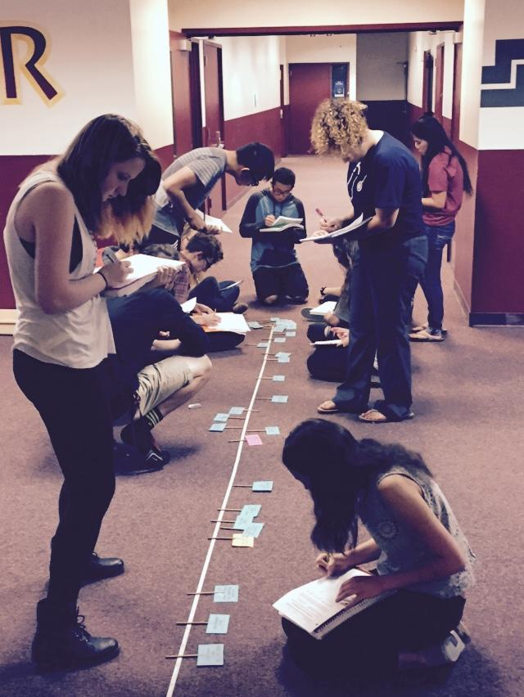
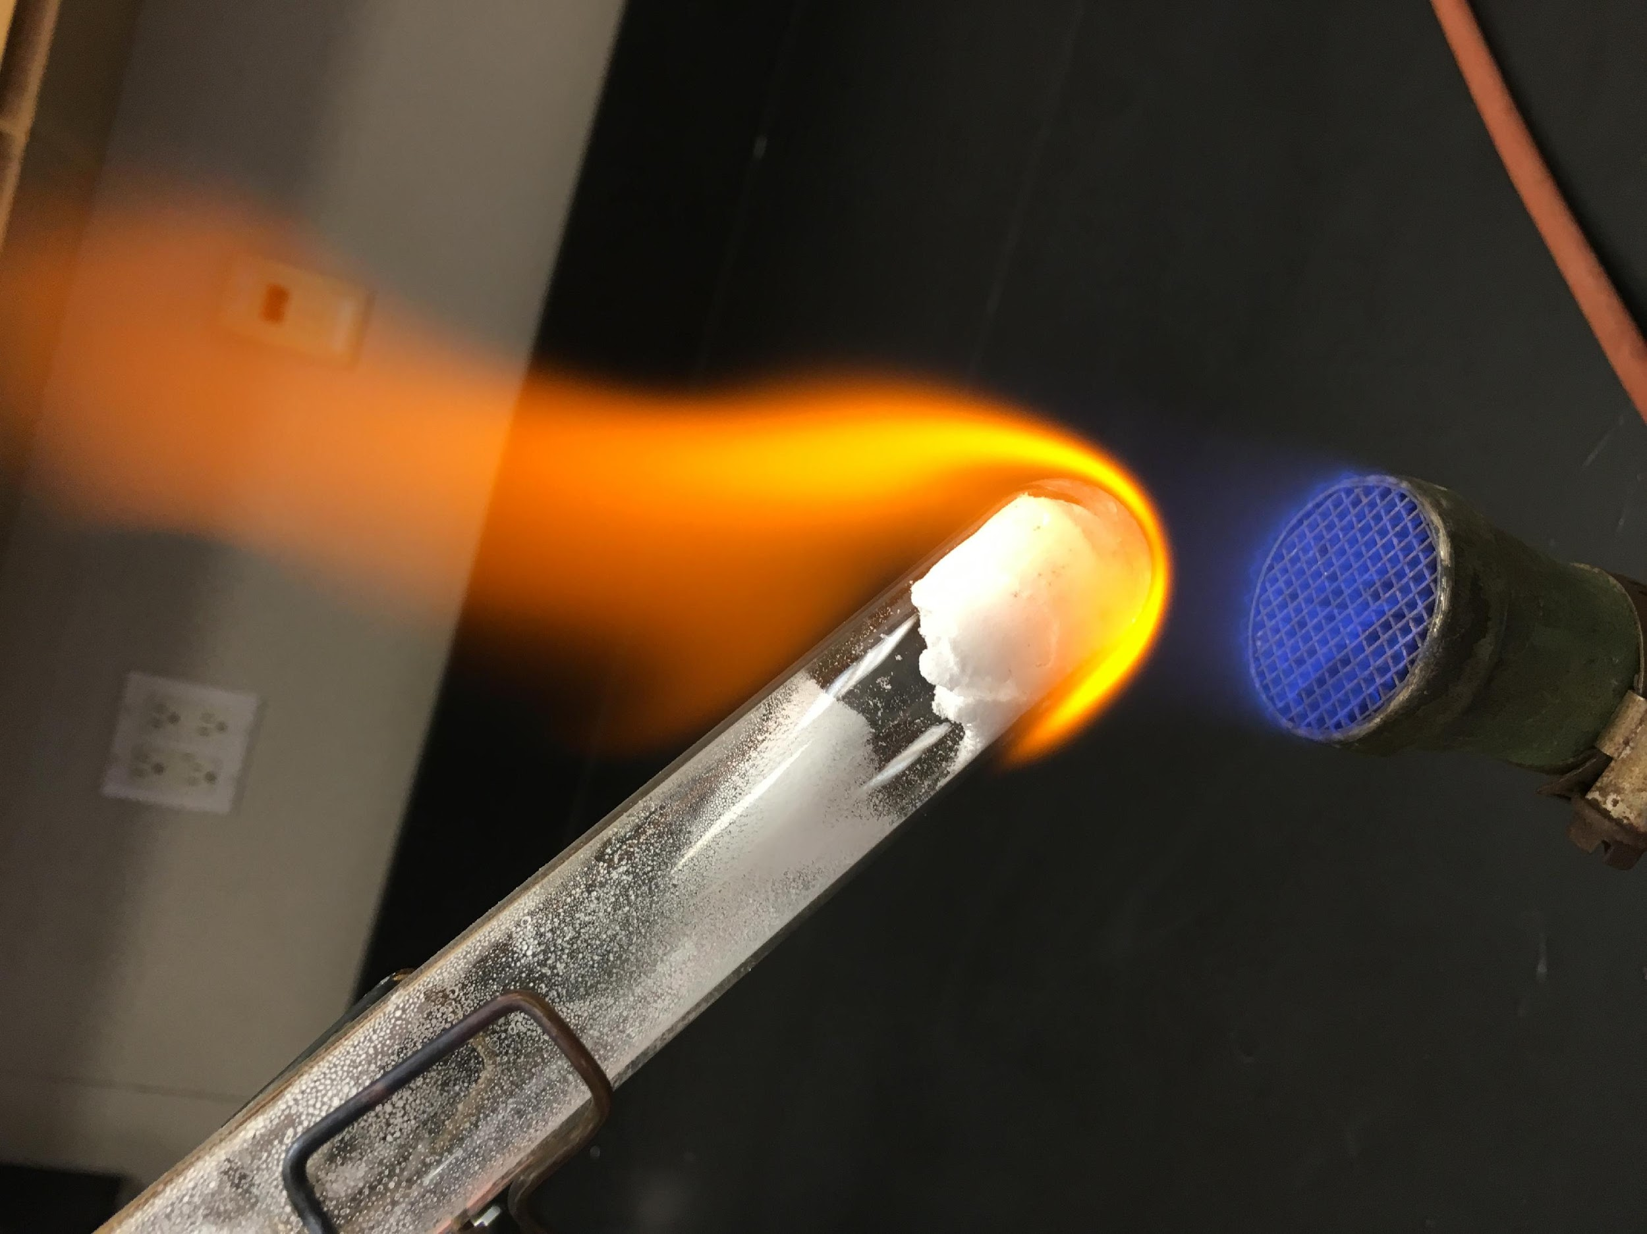
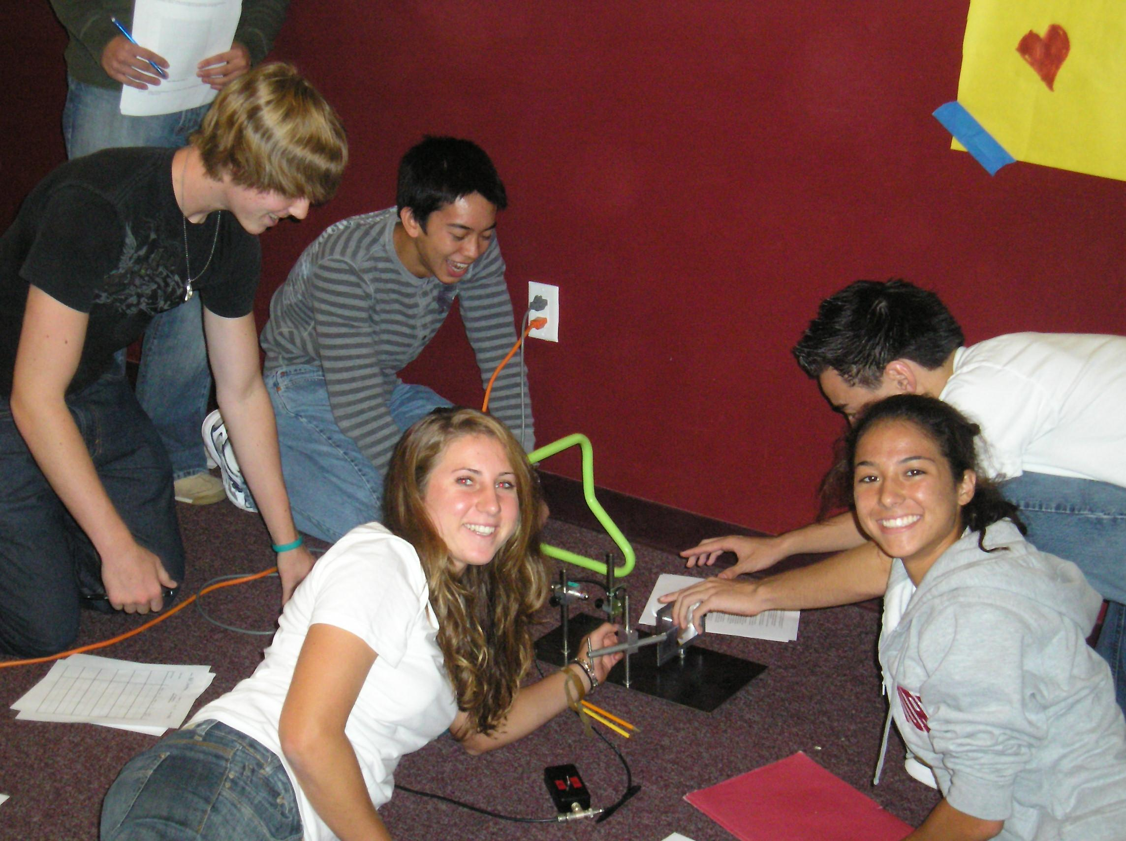
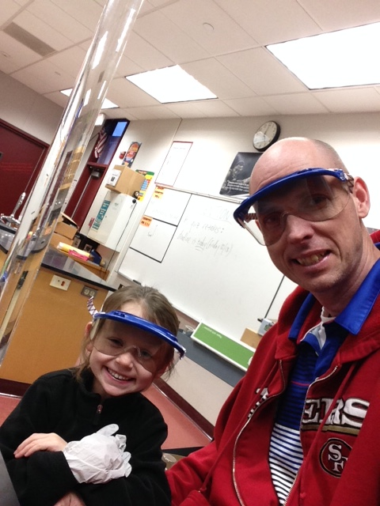
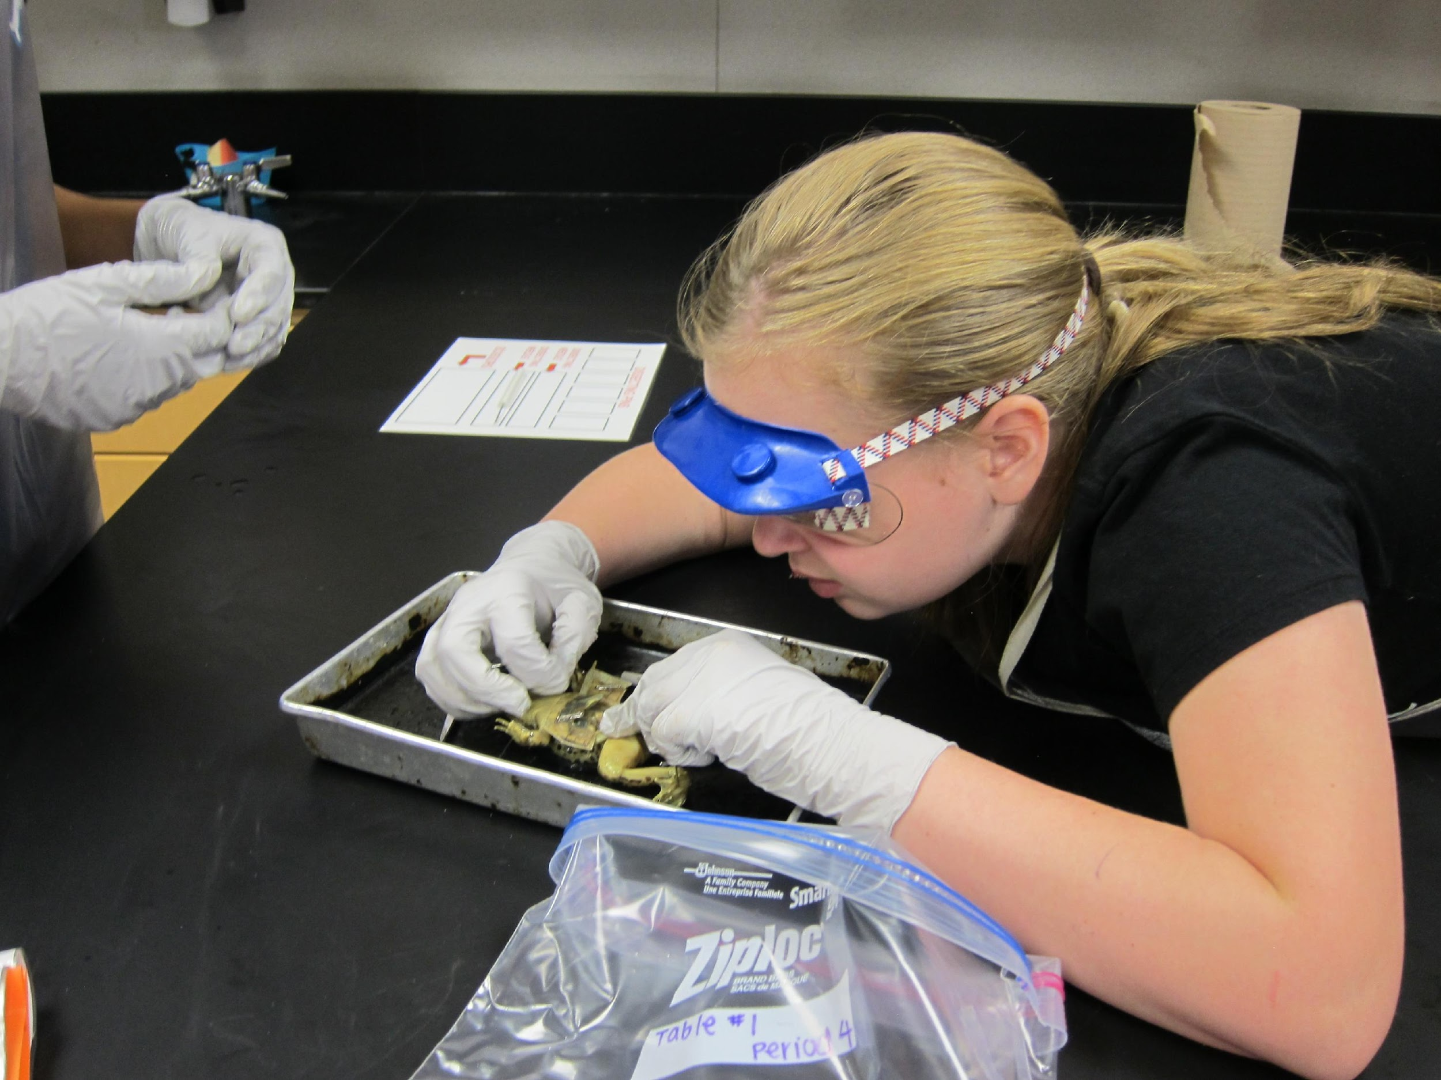
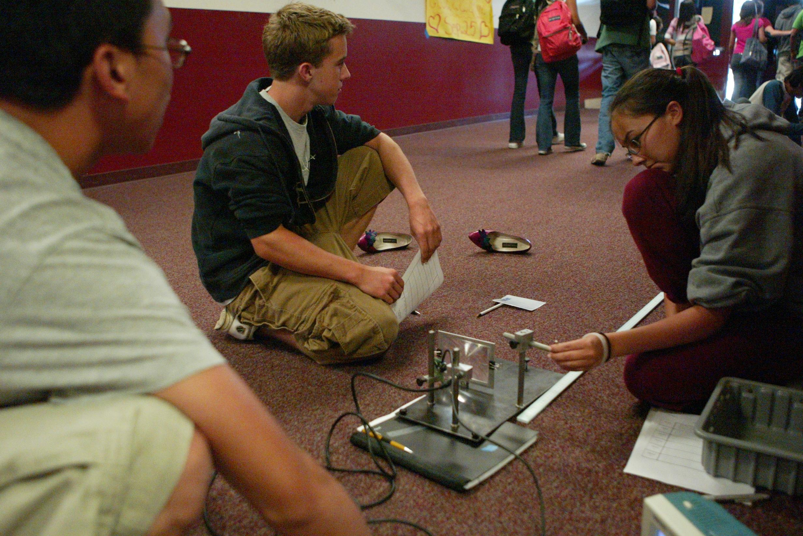
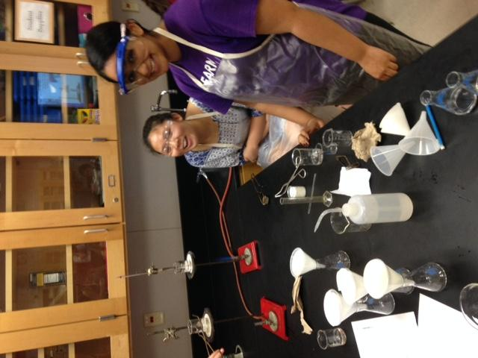
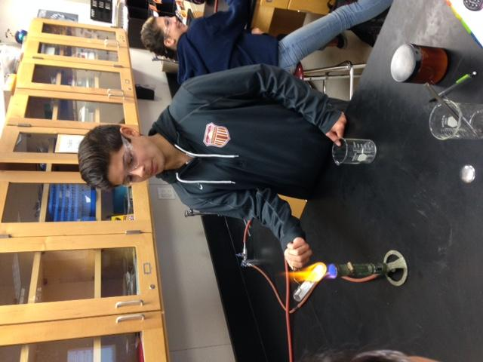
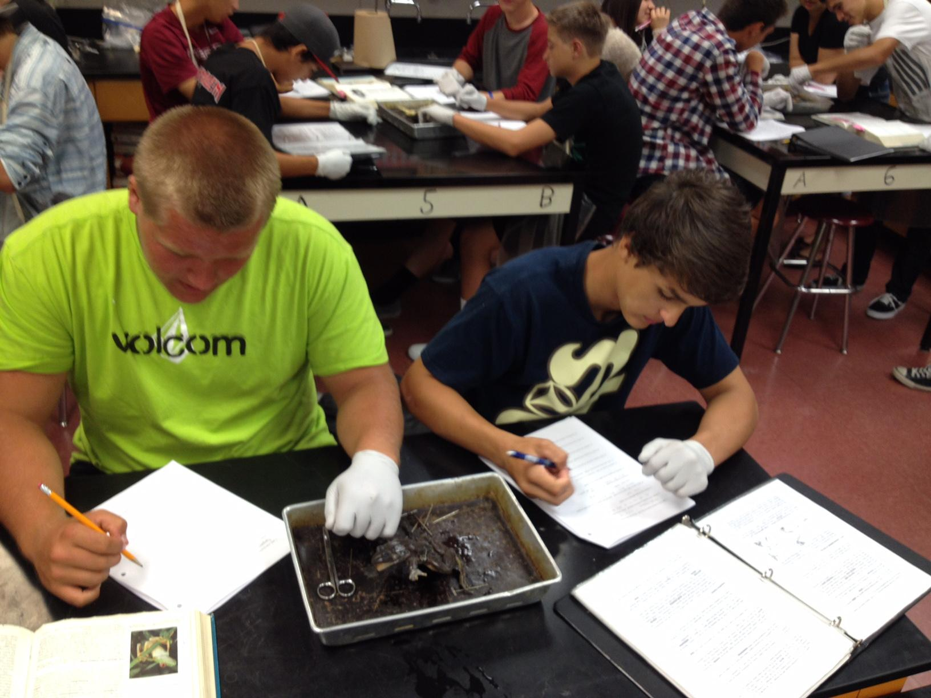
HANDS-ON SCIENCE ACTIVITIES HELP OUR STUDENTS TO LEARN

Slide 29
SCIENCE CLASS REQUIREMENTS
All science courses maintain a high quality level of rigor for our students.
Organized science notebooks combined with detailed lab reports exist in all science classes.
Students are encouraged to actively participate in their own learning.
Collaborative grouping is a key component in the science experience.
AP level classes require MUCH individual determination and effort outside of the classroom.

Slide 30
MATH COURSES SHOULD PROGRESS ALONG WITH THE MORE CHALLENGING SCIENCE CLASSES
READING AND WRITING SKILLS VARY PER SCIENCE CLASS
Math Skills |  | Reading/Writing Skills
AP Chemistry, AP Physics AP Biology, Physics AP Environmental Science | More | AP Biology AP Environmental Science AP Chemistry, AP Physics Physics
 | ⇳
 | Less

Slide 31
DISTINGUISHED SCHOLARS
SCIENCE COURSE SEQUENCE
9th grade 10th grade 11th grade 12th grade
Honors Biology
Honors Chemistry or
Physics
Honors Chemistry or
Physics or
AP Environmental
Science or
AP Chemistry or
AP Biology or
AP Physics 1 or
AP Physics 2
Chemistry typically
finished by now.
Physics or
AP Environmental
Science or
AP Chemistry or
AP Biology or
AP Physics 1 or
AP Physics 2
Note: Science focused students and
engineering focused students usually
follow the yellow sequence.

Slide 32
THANK YOU FOR YOUR ATTENTION!
We look forward to helping your student reach their individual science goals here at Esperanza High School.

Slide 33
Social Science
Heather Waugh

Slide 34




Social Science AP Courses
Freshman year= AP Human Geography (elective)
Sophomore year= AP European History
Junior year= AP United States History
Senior year= AP US Government (semester)
Senior year= AP Macroeconomics (semester)

Slide 35

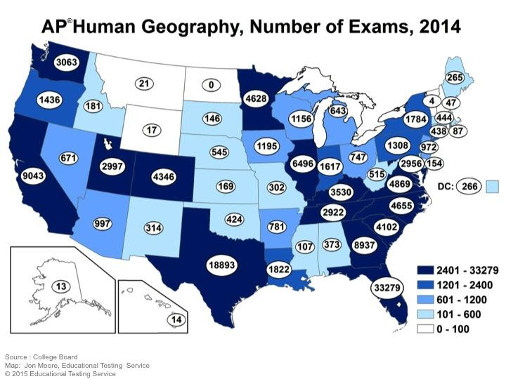
AP Human Geography
Course Overview: “The Why of Where”
Equivalent of a one-semester, introductory college course in Human Geography
APHuG is the branch of the social sciences that deals with the world, its people and their communities, cultures, economies, and interaction with the environment by emphasizing their relations with and across space and place.

Slide 36
AP Human Geography
Why Take it?
Only Freshman AP class offered
Distinguished Scholar
Helps prepare you for future AP courses
How to fit it in my schedule?
Take it as one of your elective courses
Take Health/Careers in summer prior to 9 grade or postpone to another summer

Slide 37


AP European and United States History
Teachers work together to create seamless transition
College Board Redesign
  Importance of critical thinking, reading, and writing
  Students are expected to think as historians as they study the interaction of Europe/United States with the world
  Increased emphasis on primary and secondary sources and students ability to evaluate various historical interpretations
  Students are expected to recognize/evaluate continuity and change over time, comparisons across time and place, and historical causation

Slide 38


AP European and United States History
Equivalent to a college introductory class
Weekly homework- at least 30 minutes a day
  Monthly calendars
  Ability to budget time & plan ahead
  Review past material

Slide 39
AP European and United States History
Willingness to ask questions and ask for help when needed
  Homework & Writing
  Test taking- strategies and study techniques
Perseverance!!! Students must learn how to read a true college level textbook
Participation and Discussion

Slide 40

AP European and United States History
AP US-96% pass rate past 5 years
  2015- 40% of students earned a 5 (national average = 9%)
AP Euro- approx. 70% (2016)
  National average (2016)- 53%

Slide 41

AP US Government
Teacher: Mr. Matthews
Students learn how the US Constitution has evolved over time.
Students learn about how the institutions of government interact with each other.
Students learn how people can influence public policies and why some groups have more influence than others.
Average pass rate over 90% the past few years.

Slide 42


Slide 43


Slide 44
World Language
Nadine Elwood
Catrina Lim
Priscilla Stremiz

Slide 45

Course Offerings for
World Languages
French, German, Japanese, and Spanish offer:
Level 1
Level 2, 2 Honors
Level 3, 3 Honors
Level 4
AP

Slide 46
Why take Honors/AP
World Languages?
Honors courses prepare students for AP course and exam
These weighted classes look good on college transcripts
College credit for AP exam(s) passed
Students can earn the Seal of Biliteracy on diploma
Become global citizens in a competitive job market
Valuable tool in the medical field or in studies of science, literature, philosophy, and international business

Slide 47


Honors Expectations
Stronger emphasis on writing
Honors students are expected to learn more vocabulary and grammar in order to prepare for AP test
Homework assignments have increased complexity
Tests and quizzes will also have increased complexity and writing opportunities
Daily participation is a must
Honors students are expected to keep a B+ average in class

Slide 48
AP Expectations
Keep up with coursework which includes extensive test preparation (Homework and class work)
Daily attendance and participation
Work with the language outside of class by exposing themselves to as much authentic material as possible (music, film, literature, keeping up with current events with newspapers, magazines, etc.)
Language immersion weekend and/or mini-immersion weekend in Big Bear (French, German, Spanish), active participation in our WL clubs, hosting exchange students, etc.
Keep a running vocabulary list of words they encounter in test preparation that they study on their own time

Slide 49


AP FRENCH : FRANÇAIS
*Vocabulary Development:Listening, Speaking & Comprehension: Allons Au-delà / Trésors du Temps
*Literature /Writing / Grammar: Verb Tenses
*Cultural Aspects: comparisons, following current events: using internet (TV5) online research, films, and songs.
*Optional: French Student Exchange Program/ Field Trips / Pen Pals / Europe Summer Trips

Slide 50
German: Honors/AP Expectations
Honors starts in level two
  More in depth information NOT heavier work load
  Expected to participate more and always speak in complete German sentences
  Required to read level appropriate chapter books and take reading quizzes
  AATG exam: timed exam completed on computer (3rd year)
  Community service through German National Honor society
AP German has many opportunities for AP test practice
  DSD I test is free of cost and can earn students a language diploma accepted at any German university
  Resources: Deutsche Welle, Goethe Institut, German TV programs, etc.

Slide 51

Japanese AP Expectations
Kanji and culture study Summer homework
Weekly practices in reading, writing, speaking and listening for AP Prep
Weekly AP Kanji/vocab quizzes
Weekly 10-minute essays
Daily participation expected
Daily homework (30 minute minimum) plus expected 30 minutes per day extra study time
AP students are expected to know 450 kanji by the end of the year
There will be two semester projects that include essays and presentations
AP students are expected to sing the loudest and be the best singers when we sing Japanese songs ☺

Slide 52

Honors/AP Spanish
*Honors and AP courses are
individually designed and instructed
*Each course is it’s own level and course
*Designed to facilitate success on the AP
Spanish Language and Culture Exam
*Curriculum includes all aspects of
linguistic skills: writing, speaking,
listening, reading and culture.
*Integrated cultural instruction

Slide 53
Seal of Biliteracy
In order to qualify must have:
  Completed 4th year of the language or
    3 or higher on AP exam or
    +600 score on SAT II Language test
  Maintained a 2.0 GPA in ELA classes all four years
  Maintained a 3.0 GPA in WL classes all four years
  Demonstrated proficiency in English by passing the ELA SBAC (common core test) taken junior year
Students receive a seal on their diploma and a medallion to wear at graduation

Slide 54
Fine Arts & Computer Science
AP Studio Art - 2D, 3D and Drawing
  Placement based on previous coursework and instructor approval
AP Computer Science Principles
  Prerequisite is successful completion of Exploring Computer Science or instructor approval

Slide 55
“AP courses gave me the opportunity and the freedom to take advantage of all my university had to offer. I was able to register for classes earlier than many of my classmates, take fewer general education courses, and best of all, study abroad for a full year in Switzerland, even as a pre-med student. Plus, think of all the units you don’t have to pay for!”
Peter Reim - class of 2013
Pepperdine University

Slide 56
“AP classes are honestly just like college classes in my experience at Penn State. Taking these classes completely prepared me for college and has helped me succeed.”
Jordan Moreno - class of 2015
Penn State University

Slide 57
“Taking AP and honors classes in high school sharpened my analytical skills and prepared me to start thinking for myself, something which college has greatly expanded upon. Additionally, AP classes prepared me for the workload in college so that my transition was not too difficult. Finally, because of my AP credit I have much more flexibility in my college schedule, allowing me to explore my interests and take courses I find fascinating.”
Allison Hidalgo - class of 2015
University of Notre Dame

Slide 58
Important Dates
Counselor registration at Middle Schools : 3/14 - 4/6
Eighth Grade Parent/Student Night : 3/22
Distinguished Scholar applications due : 3/24
Visit esperanzahs.net for more information

Slide 59
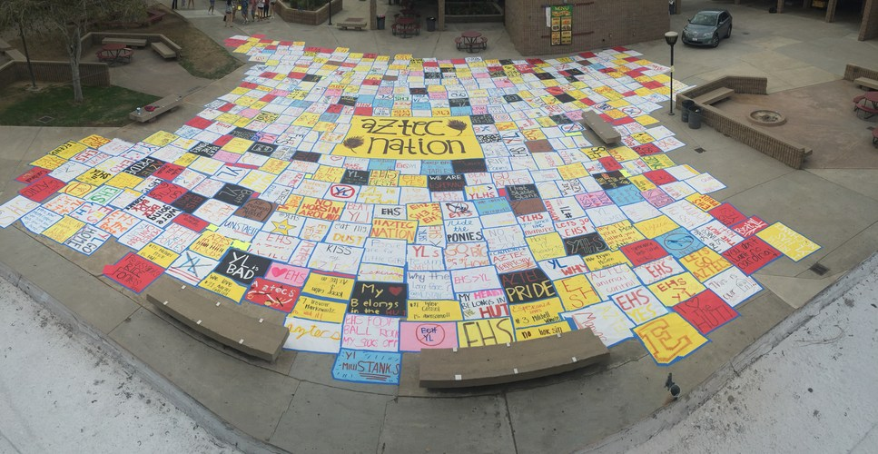
Thank you for joining us this evening!
Esperanza High School
“Where Excellence is a Tradition”

